Slide 1
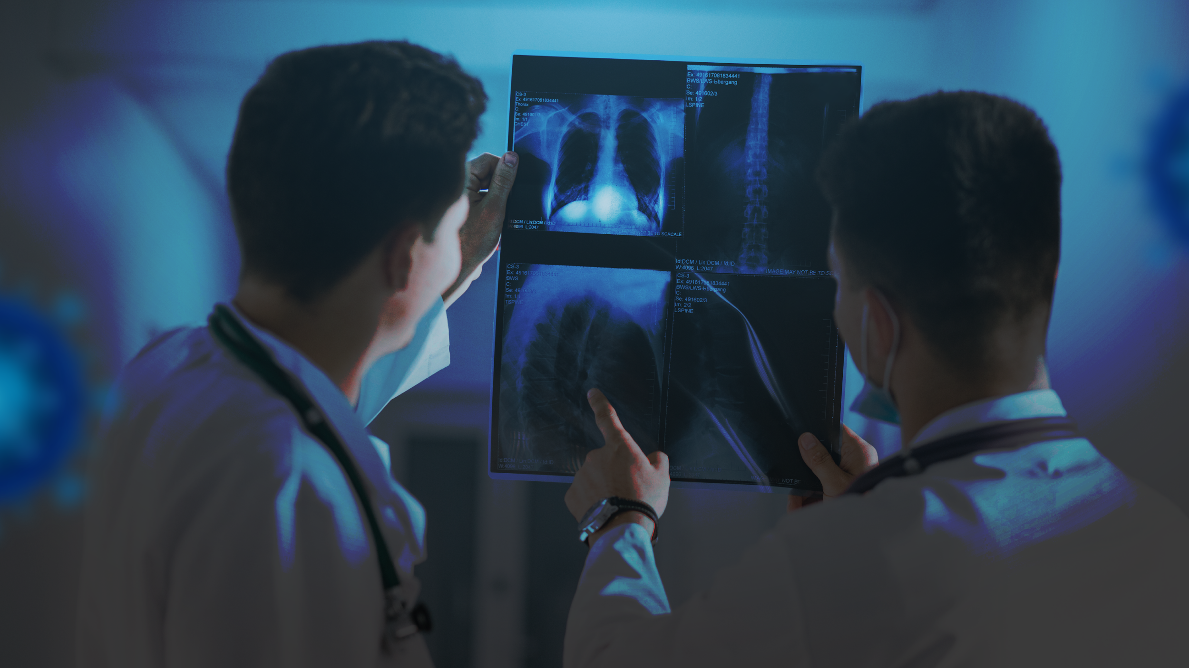

Detecting Pneumonia
Using Convolutional Neural Network

Slide 2
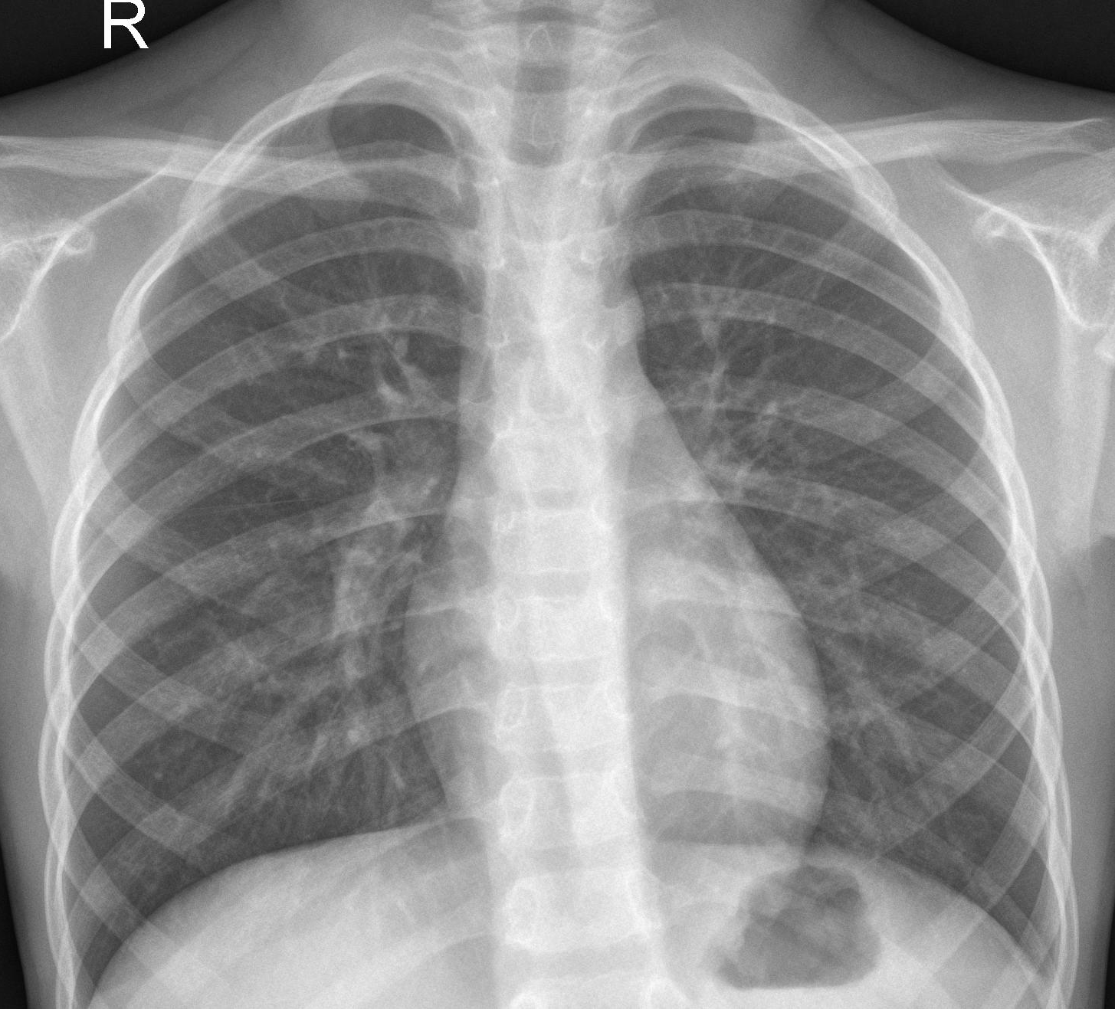
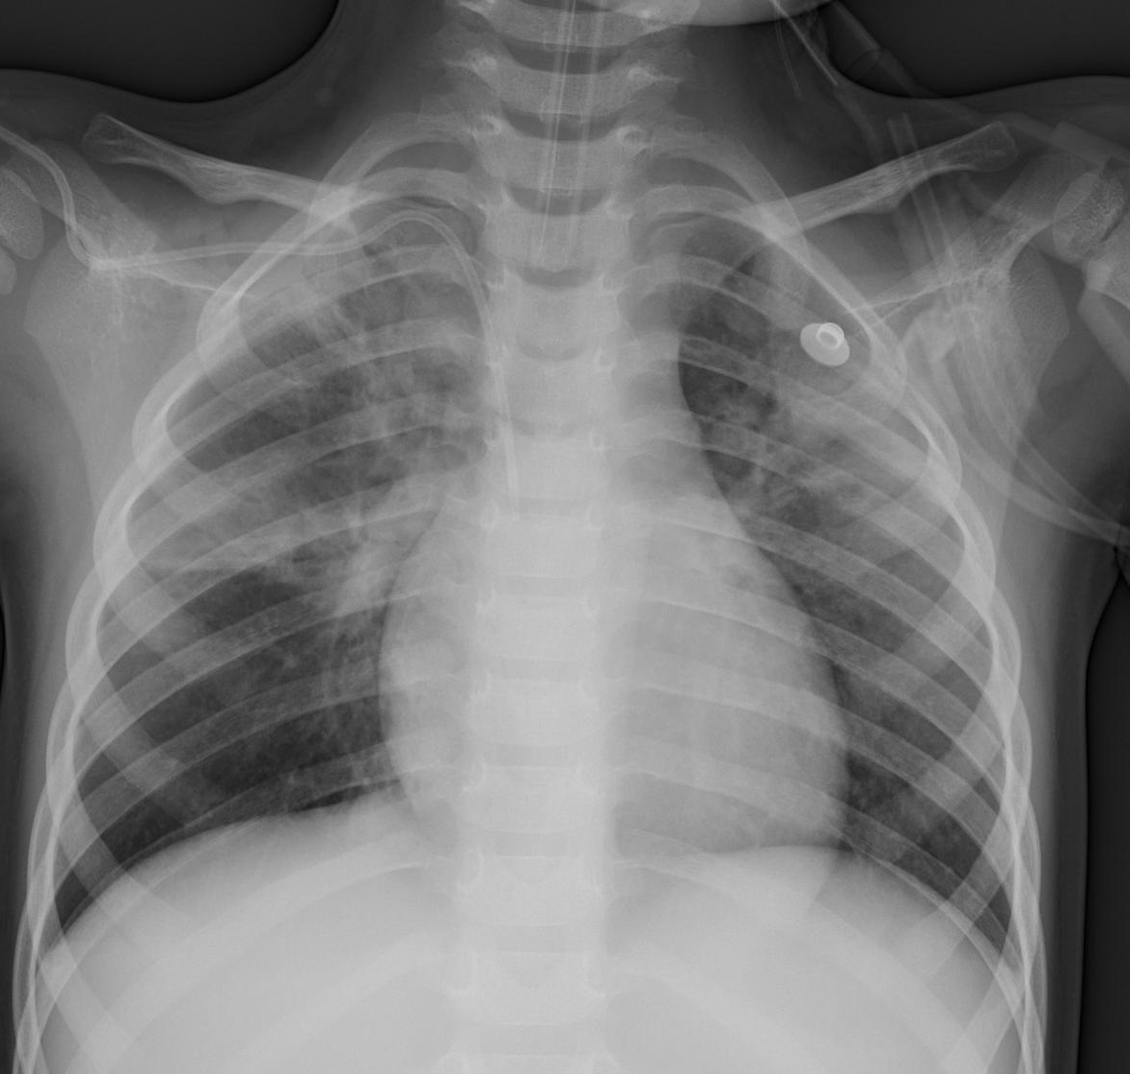
Objective
To enable Doctors quick detection of Pneumonia Patients at times of high workload.
The Keras Convolution Neural Network will classify the patients into “Normal” and “Infected” category.
Doctors have the final decision to determine if the patient has Pneumonia.
Normal
Infected

Slide 3
Agenda
01
02
03
Tools Used & Data Preparation
Tools used and Images are preprocessed
The Keras CNN Model & Results
Setup, run and evaluate the preformance
Future Improvements
What can we do to advance this Study?

Slide 4





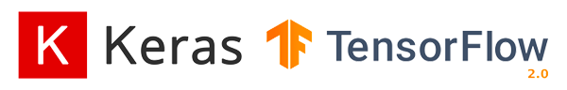

01 Tools Used
Setup CNN Layers Run and “Tune” the Model
Import Images for Train / Test / Validation
Evaluate the Performance of the Model
Display Results
01
02
03
04

Slide 5
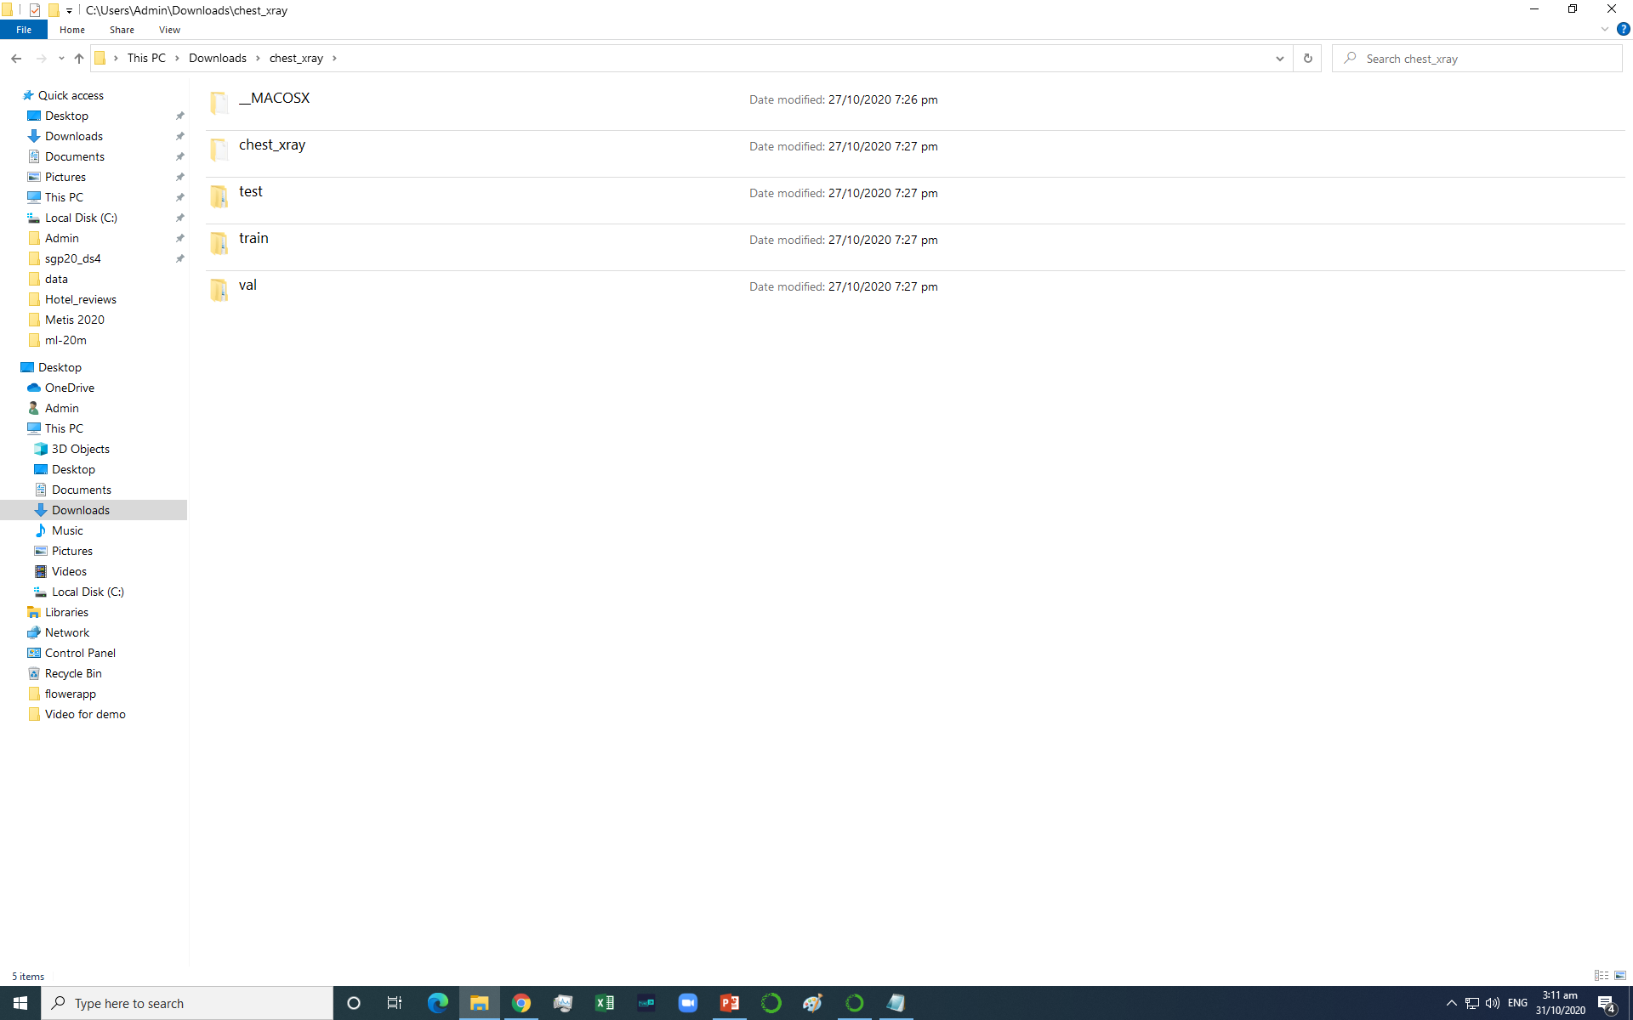

01 Data Preparation
Dataset Structure
Normal = ‘0’
Infected = ‘1’
Total: 5,856 X-ray images
x test: ‘0’ ,’1’
y test : ‘0’ ,’1’
x train : ‘0’ ,’1’
y train : ‘0’ ,’1’
x val : ‘0’ ,’1’
x val : ‘0’ ,’1’
1109
3752
Data Augmentation
995
Data Source:
https://www.kaggle.com/paultimothymooney/chest-xray-pneumonia

Slide 6
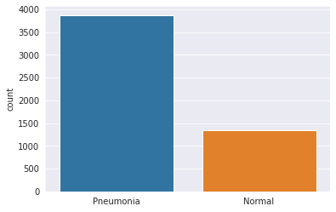
01 Data Preparation
Data Augmentation
Training dataset: Data Imbalance
Randomly rotate images by 30 degrees
Randomly zoom image by 20%
Randomly shift images horizontally by 10%
Randomly shift images vertically 10%
Randomly flip images
To increase the diversity of training set

Slide 7
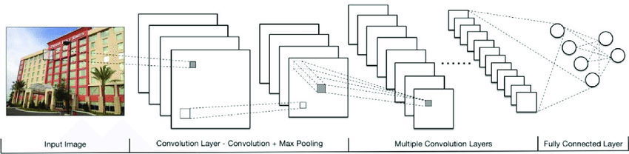
02 The Keras CNN Model
Output:
Is it a
Normal
Or
Infected
X-ray Image?
Conv2D
MaxPool2D
Batch Normalization
Dropout
Flatten
Dense
Compile

Slide 8
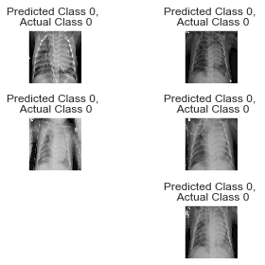
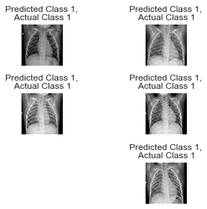
02 The Results
92% Precision 97% Recall
True Negative
True Positive

Slide 9
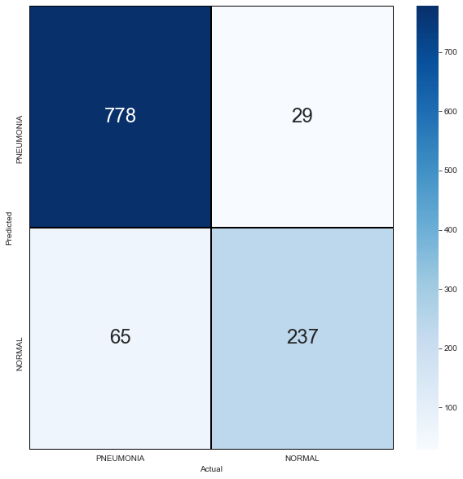

02 The Results
Confusion Matrix
on Test Dataset
 | precision | recall | f1-score | support
Pneumonia (Class 0) | 0.92 | 0.97 | 0.94 | 807
Normal (Class 1) | 0.89 | 0.78 | 0.83 | 302
Doctors will have to exam False Positive and False Negative cases to classify them correctly.

Slide 10
03 Future Improvements
To Include Covid-19 cases in future studies
To Explore possibility of using CNN on MRI and CT Scans, in Cancer Patients
01
02
To Add more CNN layers for better Precision and Recall performance
03
04
To Run CNN on pySpark to reduce the processing time.

Slide 11
Thanks
Do you have any questions?
Follow me on linkedin:
https://www.linkedin.com/in/andrew-tan-is
https://github.com/guitarfly78
Please keep this slide for attribution

